Slide 1
DESIGN PROJECT
PHASE III
Group 15
Ashel augustine 44
Aswin vijayakumar 49
Akshay Kishore 21
Akshay George 20

Slide 2
The problem
Delay in receiving notices and examination schedules from offices.
Missing important notices and deadlines of assignments.
Misplacing notices.
Wastage of paper for printing notices.

Slide 3
The solution
Digital Notice board And notification app
Works same as a normal notice board the only difference is that the wooden board is replaced by a display.
They are placed every classroom.
Can only be altered by teachers
Notification app is linked to the display via a server
Any notice put in the board will appear in the app.

Slide 4

Digital Notice board
And
notification app

Slide 5
ARCHITECTURE
DESIGN

Slide 6
UML COMPONENT DIAGRAM
Used to represent the relationships between the required interfaces and ports.
Here, for example, the various interfaces are connected by lines to represent relations between them.
The non-related interfaces are separately listed.

Slide 7
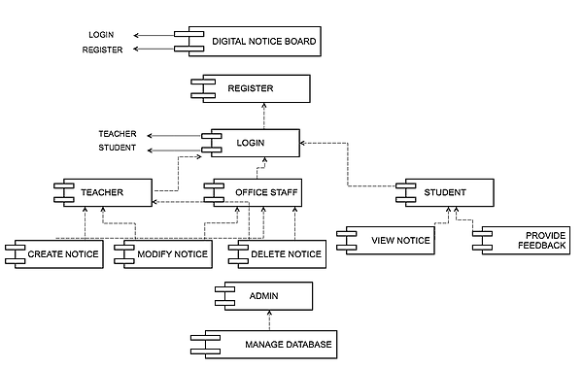
UML COMPONENT DIAGRAM

Slide 8
UML DEPLOYMENT DIAGRAM
Shows the configuration of the processing nodes at run-time and the components that live on them.
Here, the deployment target or node is the SERVER.
And the components relying on it are represented the CLIENT environment.

Slide 9
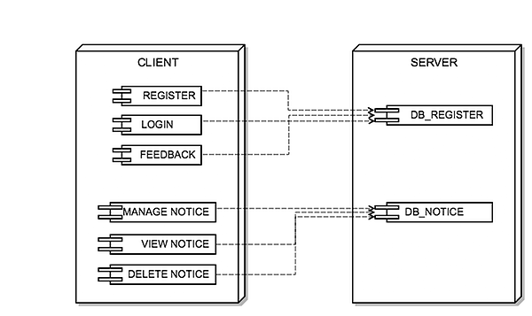
UML Deployment diagram

Slide 10
LIST OF ACTORS AND USE CASES
ACTORS
TEACHER
OFFICE STAFF
DATABASE ADMIN
STUDENT

Slide 11
USE CASES
LOGIN
CREATE NOTICE
MODIFY NOTICE
DELETE NOTICE
VIEW NOTICE
SEND FEEDBACK
MANAGE DATABASE

Slide 12
USE CASE DIAGRAM
Shows a set of USE CASES, which are sets of functionality performed by the system.
And the ACTORS which are typically, people/systems that interact with this system or problem-domain ,and their relationships.
A use case diagram actually models WHAT exactly the system is expected to do.

Slide 13
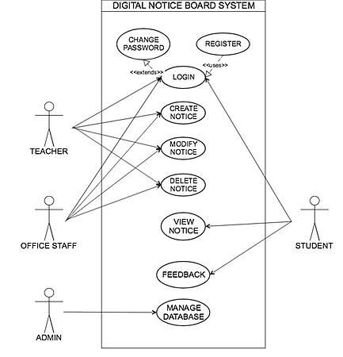
USE CASE DIAGRAM

Slide 14
Use case
specifications

Slide 15
Digital Notice board And notification app
PRIMARY ACTORS
-Teacher. -OfficeStaff. -Admin. -Student.
PRE-CONDITIONS
-The server is up and running.
-There exists an active connection between the server and the digital notice boards and the notification app and website.

Slide 16
BASIC FLOW OF EVENTS.
The authorised personnel, may it be a teacher or an office staff, registers on the website and logs in using the username and password.
Then, a notice is created in the webpage which is directly loaded into the server and then to the respective digital noticeboards in the classrooms.
It is also sent to the notification app installed in the students’ mobile, which notifies the student about the new notice being created.
The student can send a feedback if necessary which will be displayed in the website for the authorised people to see.
These notices can also further be modified accordingly or removed if necessary.
Deadlines can also be set for the notices, nearing which, an indication will be shown in the notice board and also in the app.
A notice is automatically removed once the deadline is crossed.
The database admin monitors the servers for any errors if any and provides the required maintenance.

Slide 17
1. Login
During LOGIN, the Teachers or Office staff can log into the webpage using their respective usernames and passwords, so that only the authorised personnels can have the permission to create notices.
The students also need to login to the app as, only the students of the respective classes need to get notices for that class.

Slide 18
2. CREATE NOTICE
Notices can only be created by the authorised personnels.
While creating notices, personalised notices can be made which are meant for particular classes only.
It must also be noted that notices should not be created by people other than the authorised people, else it cam be misused.

Slide 19
3. Modify notices
Notices which need to be edited after being created can be manipulated accordingly if necessary by the teachers or the office staffs.
It enables the authorised people to modify the notices as per requirement. Eg. If there is a postponement of date.

Slide 20
4. Delete notices
Notices that are not required any longer can be deleted.
Notices that were unknowingly displayed, or containing wrong information can be deleted as per required by the authorised people.

Slide 21
5. View notice
A student can view the notices created by the teachers and office staffs in the digital notice boards placed inside the classes.
They can also view the notices through their respective notification apps even if they are not inside the college campus.

Slide 22
6. Send feedback
The students can send their feedbacks or queries about a particular notice to the respective creators.

Slide 23
7. Manage database
Database containing the notices stored in the servers need to be constantly monitored and maintained if necessary.
This is done by the database admin.

Slide 24
SCREEN FORMATS.
(NOTIFICATION APP-NOTIFIED)

Slide 25

Splash Screen

Slide 26
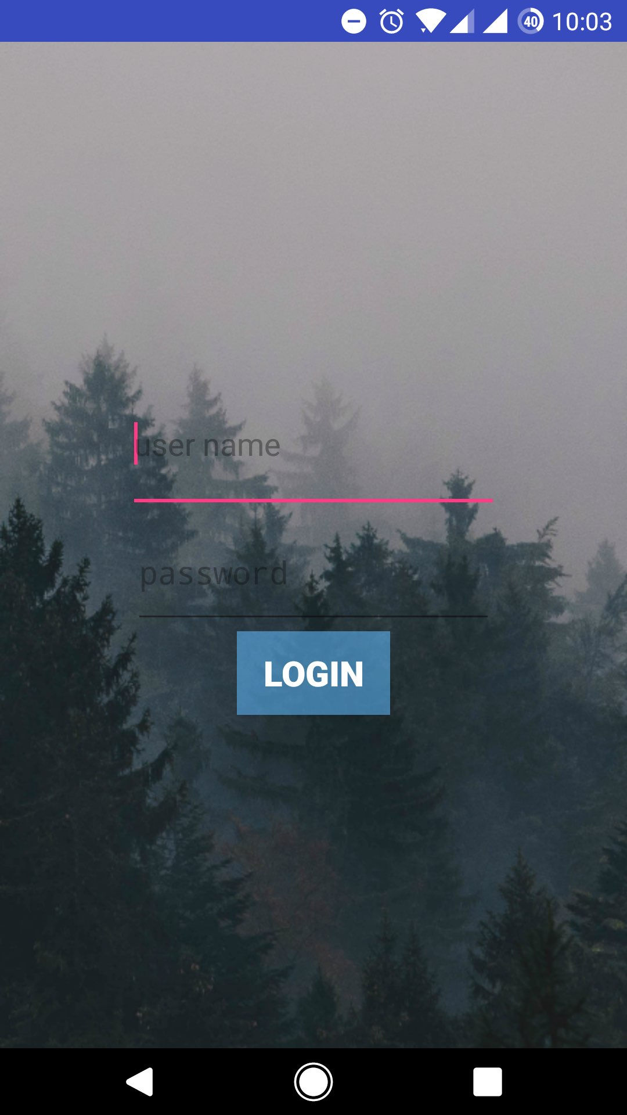
Login Screen

Slide 27
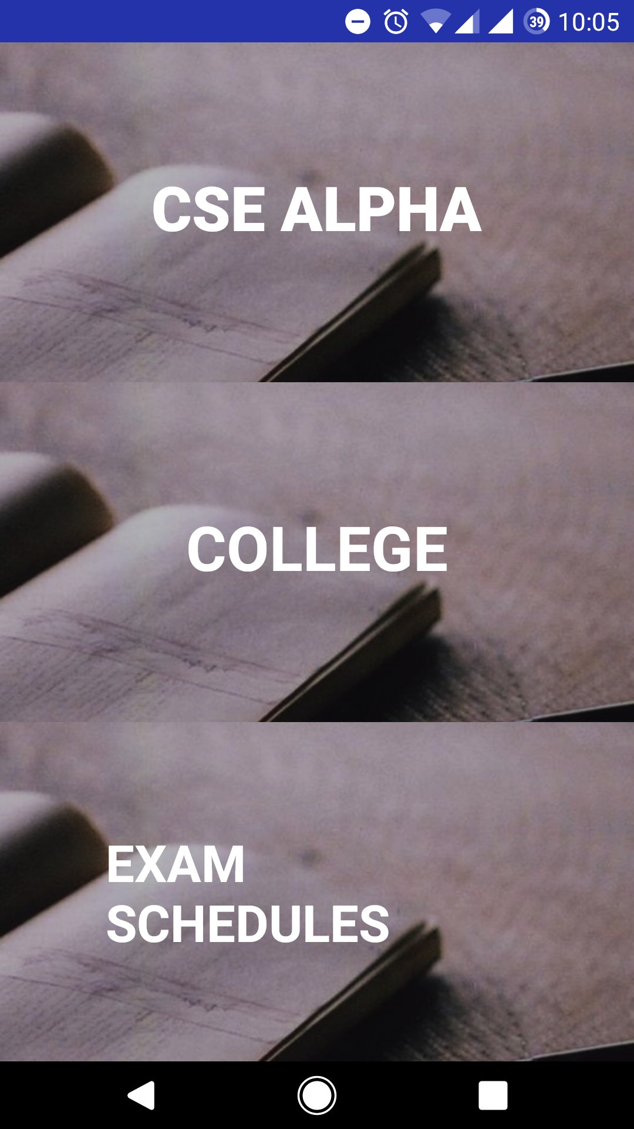
Menu List Screen

Slide 28
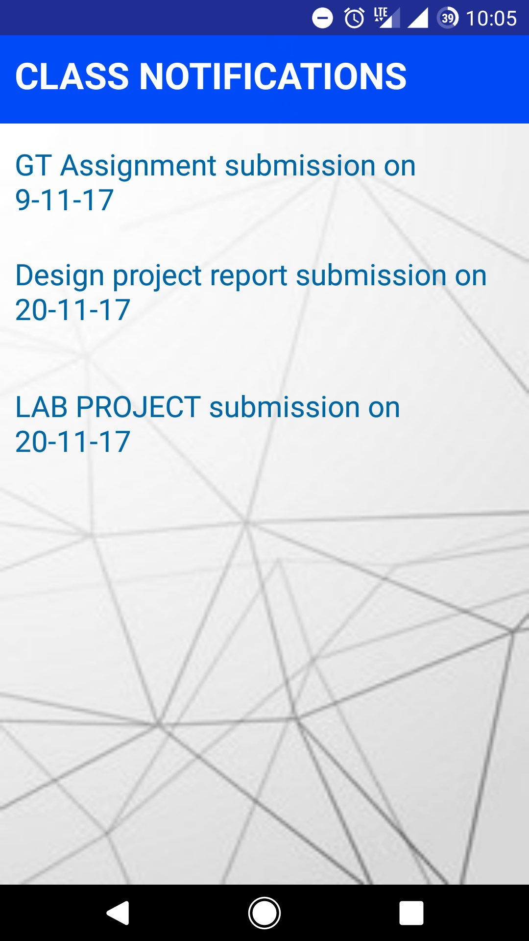
Class Notices Screen

Slide 29
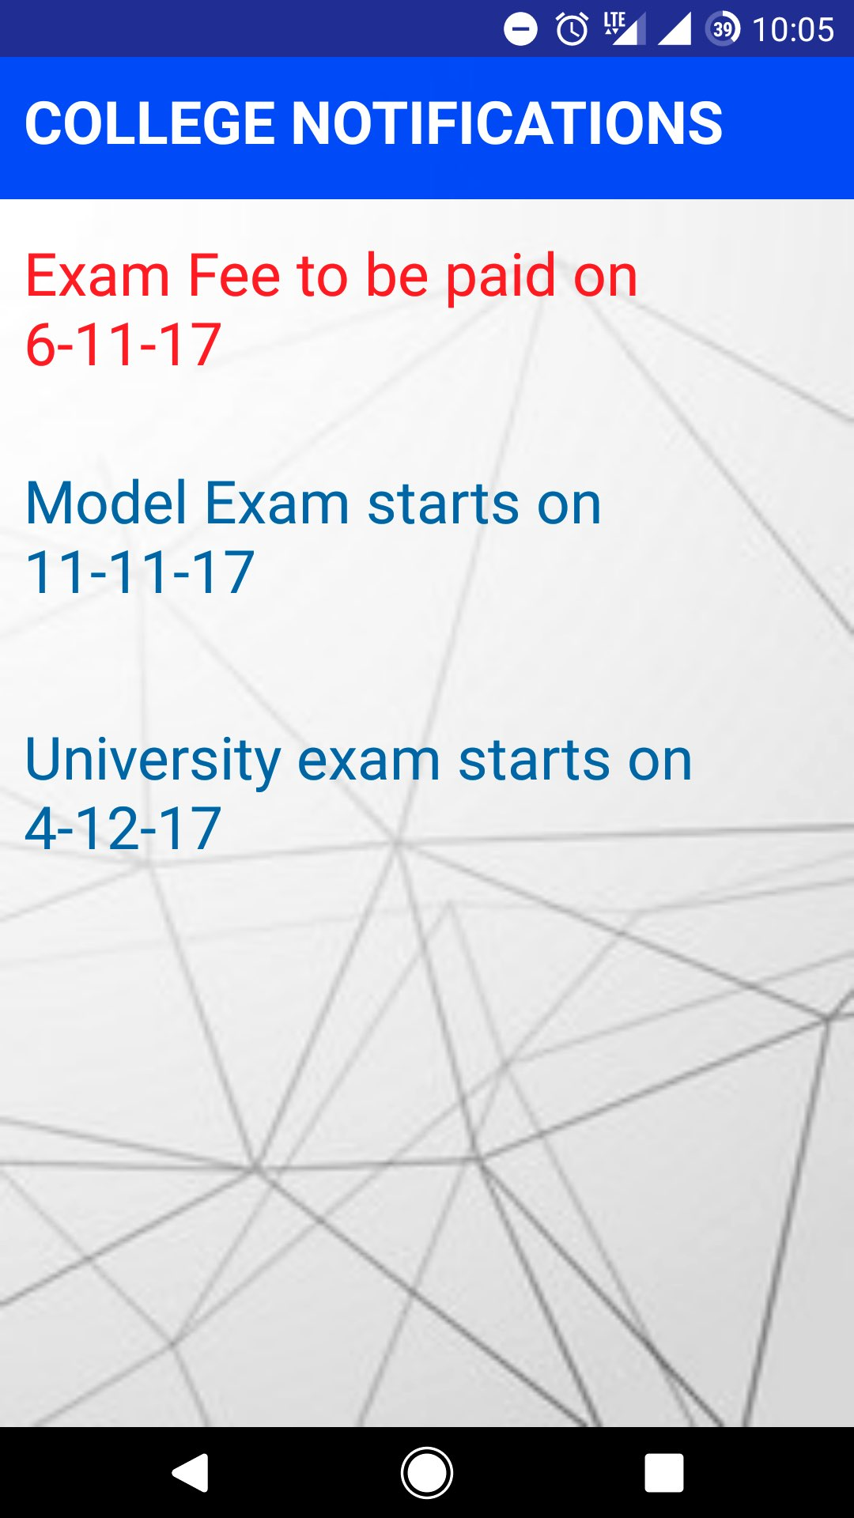
College Notices Screen

Slide 30
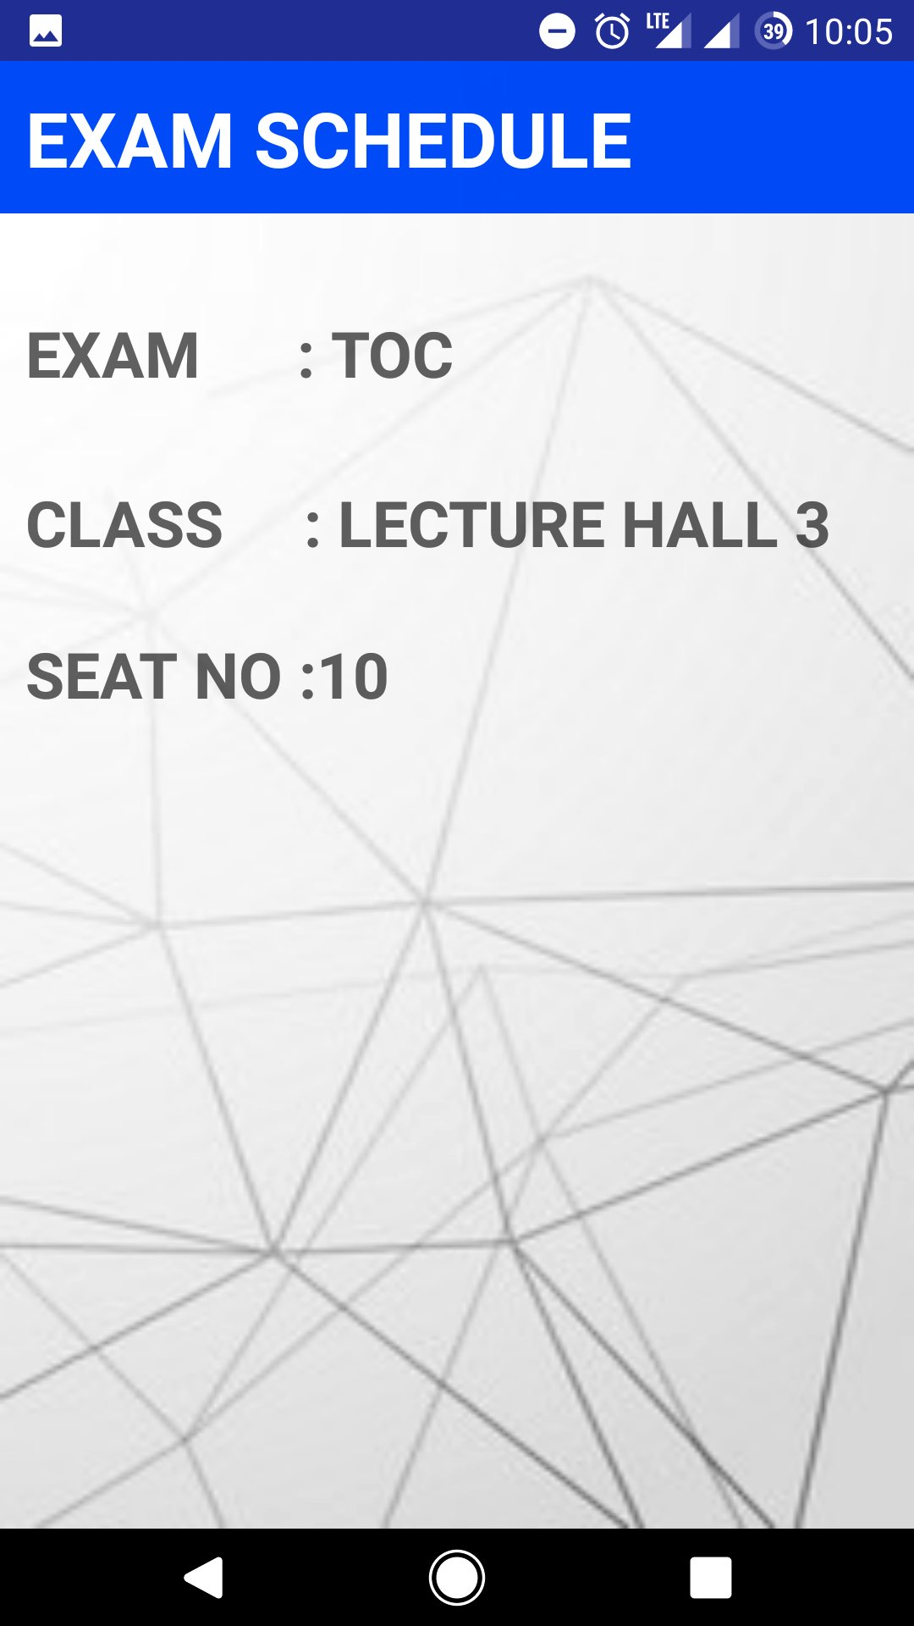
Exam Schedules Screen

Slide 31
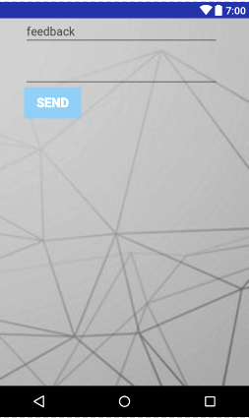
Feedback Screen

Slide 32
SCREEN FORMATS.
(WEBPAGE)

Slide 33
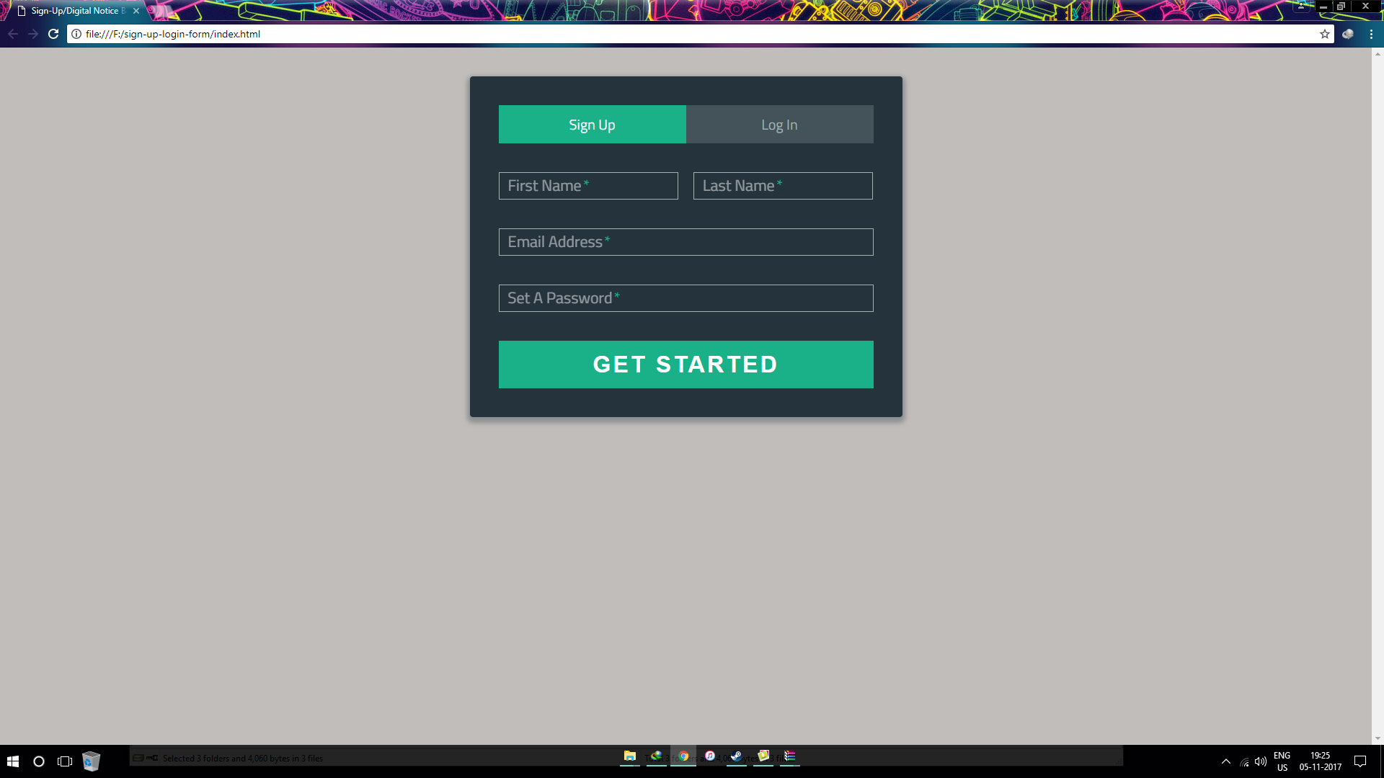
Register Screen

Slide 34
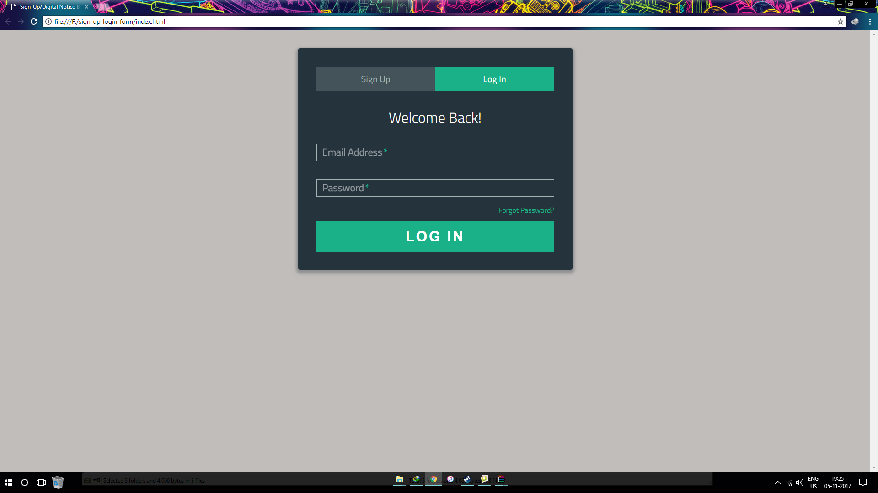
Login Screen

Slide 35
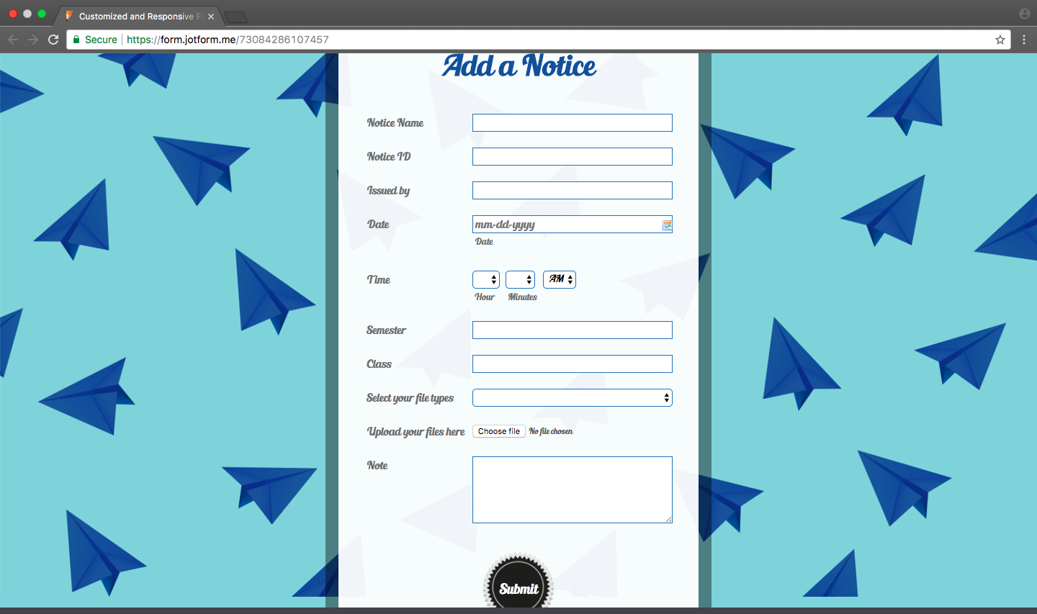
Notice Creation Screen

Slide 36

Notice Creation Screen 2

Slide 37
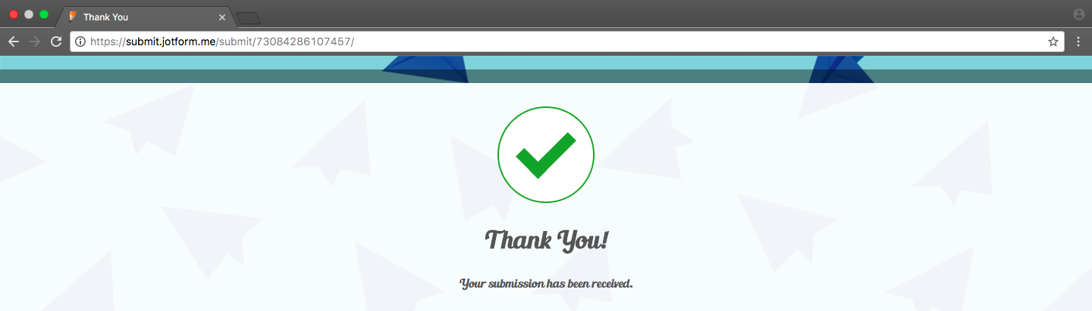
Notice Acceptance Screen

Slide 38
ANALYSIS MODEL

Slide 39
ANALYSIS MODEL
An analysis model is the most basic and first technical representation of a system.
It uses a combination of texts and diagrams to represent the various requirements in the working of the model.
In UML, analysis models are depicted with the help of SEQUENCE DIAGRAMS.
SEQUENCE DIAGRAMS model the flow of control between use cases by depicting the interaction between various objects by messages passing, with a temporal dimension to it.

Slide 40
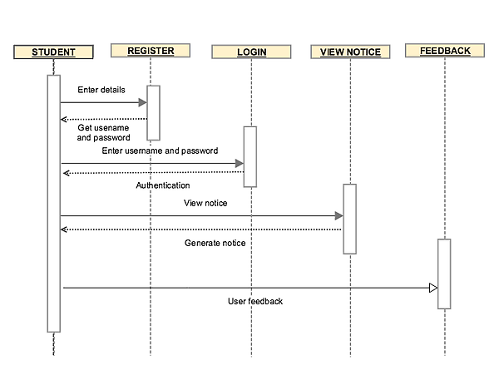
MODEL 1 : STUDENT

Slide 41
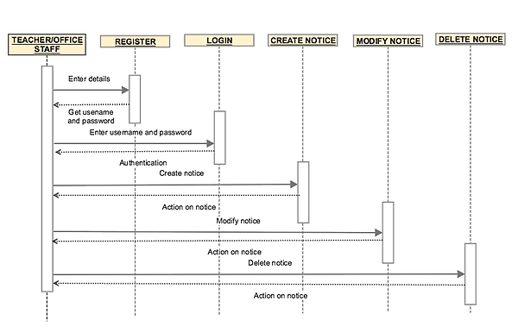
MODEL 2 : TEACHER/OFFICE STAFFS

Slide 42
DESIGN MODEL

Slide 43
DESIGN MODEL
The design model is an object model describing the realisation of use cases, and serves as an abstraction of the implementation model and its source code. The design model is used as essential input to activities in implementation and test.
A Class diagram in the UML is a type of static structure diagram that describes the structure of a system by showing the system's classes, their attributes, methods(operations), and the relationships among objects.

Slide 44
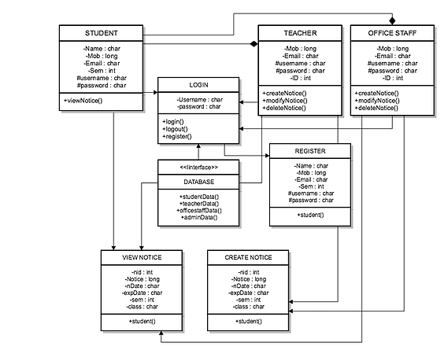
CLASS DIAGRAM

Slide 45
Here, the class diagram represents the various classes like STUDENT, TEACHER, LOGIN, VIEW NOTICE etc.
It also shows us the properties of the various classes by displaying its attributes like Name, Mob, Sem etc.
The operations of the various classes can also be seen from the methods listed under each class like, login(), viewNotice() etc.
Thus, a design model using the CLASS DIAGRAM clearly explains to us the involved factors and the working of the solution to the problem we discussed.

Slide 46



